Slide 1
Audio Event Detection via Deep Learning in Python
Coop, Ph.D.
Director of Machine Learning
phData, inc.

Slide 2


About the author
Robert Coop, Ph.D. → Coop
Director of Machine Learning, phData
Machine learning since 2008
https://www.linkedin.com/in/rcoop/

Slide 3
Agenda
01
02
03
04
Introduction
Objective and motivation
Representing audio
Time/signal domains, spectrograms
Deep learning for audio
Convolutional neural networks, VGG, VGGish
Use case: Recognizing commands
Publicly available data for research

Slide 4
Introduction
01
Objective and motivation

Slide 5
Objective
Enable the listener to use open source tools and pre-trained neural networks for audio analytics projects
What should you take from this?

Slide 6

Motivation
Scenario: audio event detection
Audio recorded from security devices and classified as hostile or non-hostile
Use best practices
Prefer approaches that have been researched and tested
Create a solution quickly
Get from zero to prototype as fast as possible

Slide 7
Representing audio
02
Digital audio, frequency scales, time and frequency domains, spectrograms

Slide 8

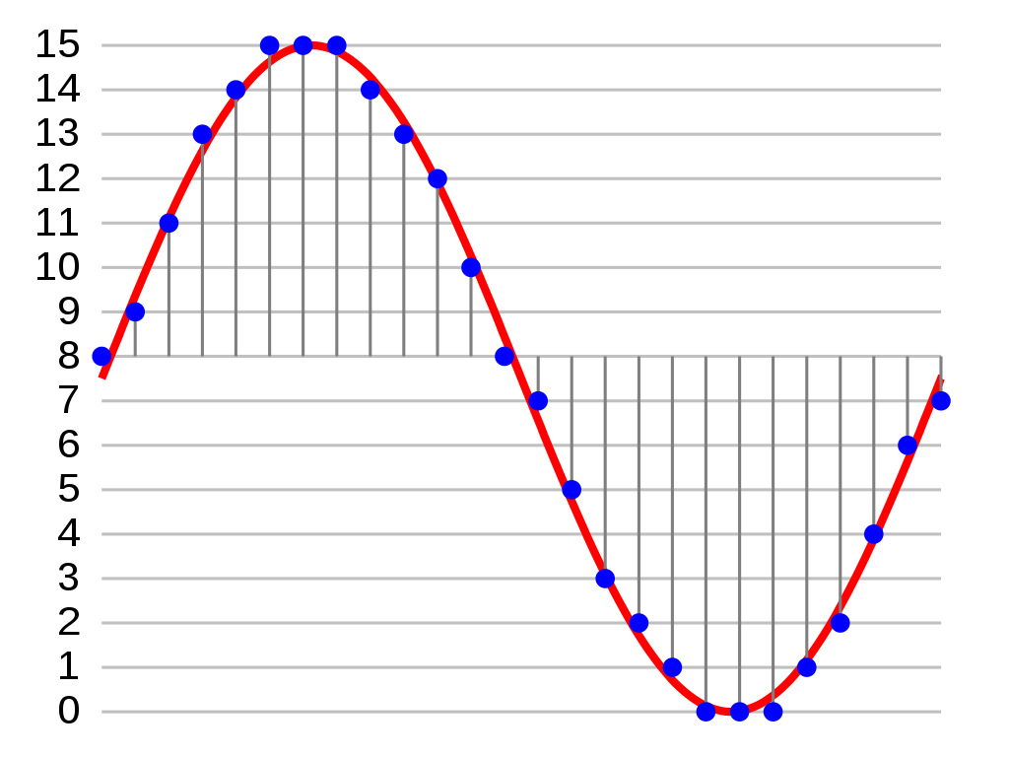
Digital audio
Waveform Audio File (WAV)
Analog-to-digital converter (ADC)
Pulse-code modulation (PCM)
Sampling rate
Bit depth

Slide 9
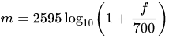
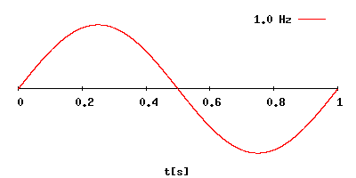
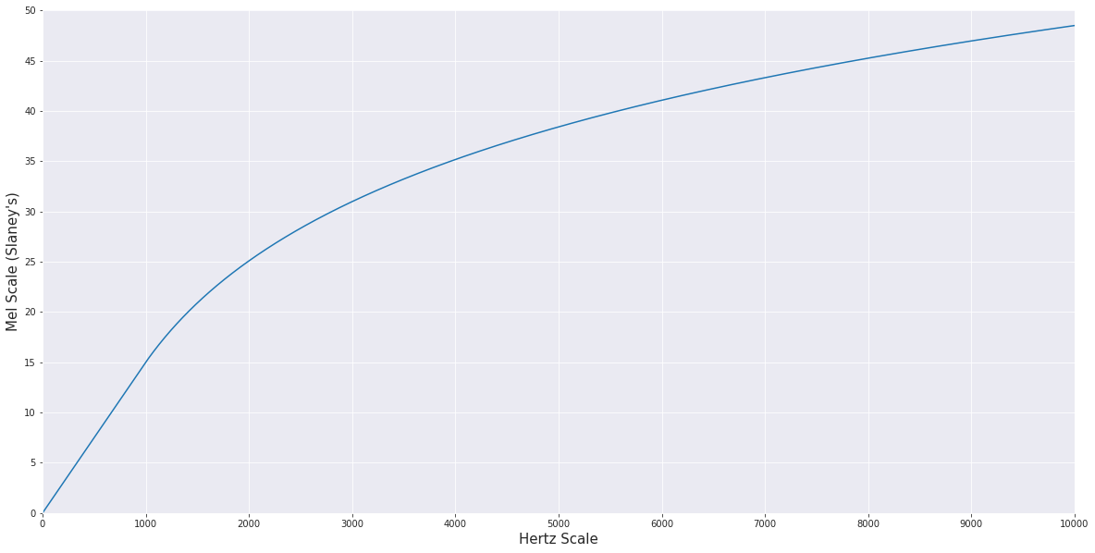
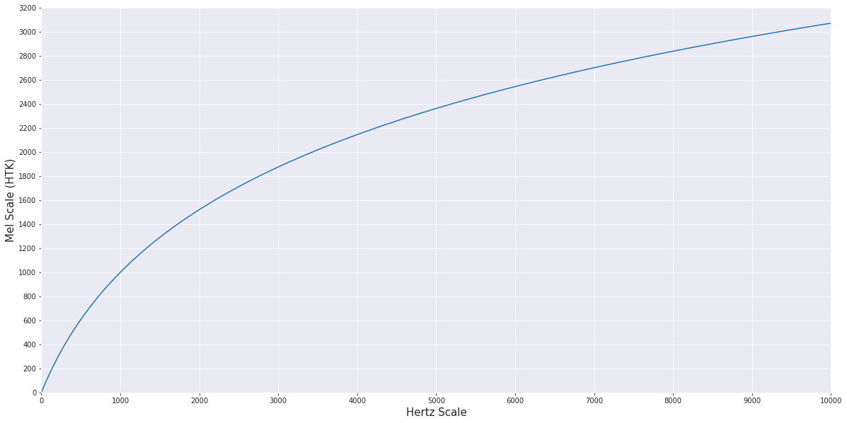
Frequency scales
Hertz (Hz) scale
Mel scale
Based on physical characteristics of sound wave
One Hertz = one cycle per second
Middle C (C₄) - 261.626 Hz
Treble C (C₅) - 523.251 Hz
Based on human perception of sound
Several different formulas exist
Slaney, M. Auditory Toolbox: A MATLAB Toolbox for Auditory Modeling Work. Technical Report, version 2, Interval Research Corporation, 1998.
Douglas O'Shaughnessy (1987). Speech communication: human and machine. Addison-Wesley. p. 150. ISBN 978-0-201-16520-3.

Slide 10

Frequency interval comparison - 100 Hz
100 Hz
6000 Hz
200 Hz
6100 Hz
300 Hz
6200 Hz
400 Hz
6300 Hz

Slide 11
Frequency interval comparison - 1.5 Mel
1.5 Mel (100 Hz)
~41 Mel (6000 Hz)
3 Mel (200 Hz)
~42.5 Mel (6652 Hz)
4.5 Mel (300 Hz)
~44 Mel (7374 Hz)
6 Mel (400 Hz)
~45.5 Mel (8176 Hz)

Slide 12
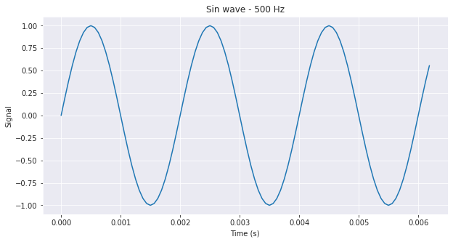
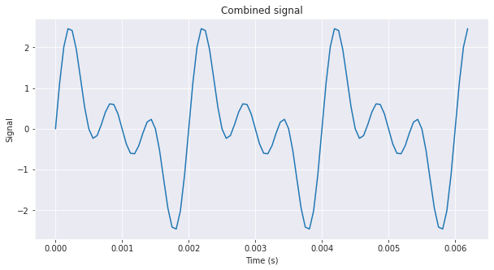
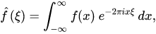
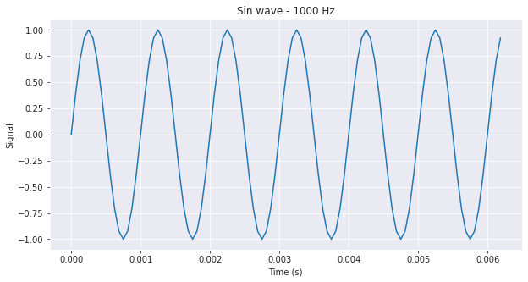
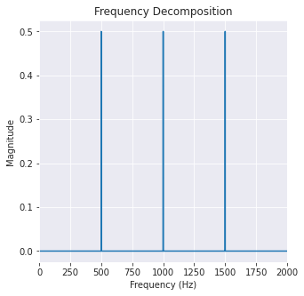
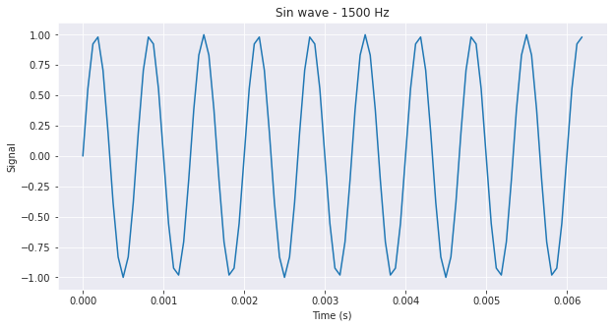
Time domain and frequency domain
Fourier transform
Decomposes signal into constituent frequencies

Slide 13
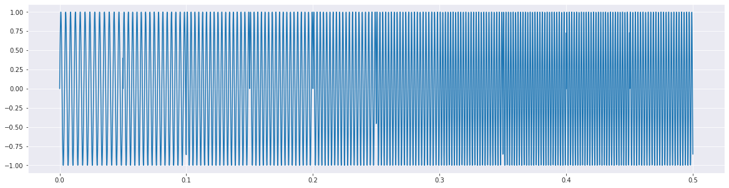
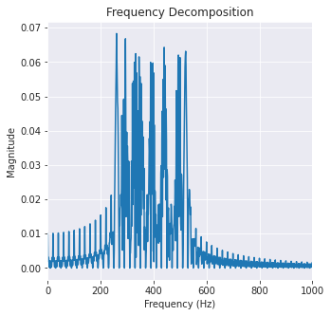
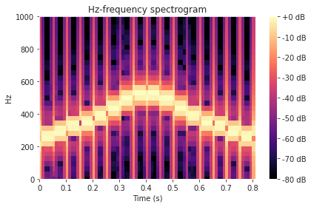
Time domain and frequency domain
Spectrograms
Frequency decompositions over time
C-major scale
Frequency decomposition is a poor representation
Spectrograms show progressions over time

Slide 14
Deep learning for audio
03
Convolutional neural networks, VGG16, VGGish

Slide 15
Processing spatial data
Flattening
0
7
7
4
3
0
1
1
2
Flatten N x N into N² x 1
Doesn’t take advantage of spatial relationships
0 | 7 | 7
4 | 3 | 0
1 | 1 | 2

Slide 16
Processing spatial data
Convolution
Use kernels to reduce dimensionality while retaining spatial relationships
1 | 1 | 1 | 0 | 0
0 | 1 | 1 | 1 | 0
0 | 0 | 1 | 1 | 1
0 | 0 | 1 | 1 | 0
0 | 1 | 1 | 0 | 0
Kernel
Input

Slide 17
Processing spatial data
Convolution
Use kernels to reduce dimensionality while retaining spatial relationships
1 | 1 | 1 | 0 | 0
0 | 1 | 1 | 1 | 0
0 | 0 | 1 | 1 | 1
0 | 0 | 1 | 1 | 0
0 | 1 | 1 | 0 | 0
Output
Input

Slide 18
Processing spatial data
Convolution
Use kernels to reduce dimensionality while retaining spatial relationships
1 | 1 | 1 | 0 | 0
0 | 1 | 1 | 1 | 0
0 | 0 | 1 | 1 | 1
0 | 0 | 1 | 1 | 0
0 | 1 | 1 | 0 | 0
4
Output
Input

Slide 19
Processing spatial data
Convolution
Use kernels to reduce dimensionality while retaining spatial relationships
1 | 1 | 1 | 0 | 0
0 | 1 | 1 | 1 | 0
0 | 0 | 1 | 1 | 1
0 | 0 | 1 | 1 | 0
0 | 1 | 1 | 0 | 0
4 | 3
Output
Input

Slide 20
Processing spatial data
Convolution
Use kernels to reduce dimensionality while retaining spatial relationships
1 | 1 | 1 | 0 | 0
0 | 1 | 1 | 1 | 0
0 | 0 | 1 | 1 | 1
0 | 0 | 1 | 1 | 0
0 | 1 | 1 | 0 | 0
4 | 3 | 4
Output
Input

Slide 21
Processing spatial data
Convolution
Use kernels to reduce dimensionality while retaining spatial relationships
1 | 1 | 1 | 0 | 0
0 | 1 | 1 | 1 | 0
0 | 0 | 1 | 1 | 1
0 | 0 | 1 | 1 | 0
0 | 1 | 1 | 0 | 0
4 | 3 | 4
2
Output
Input

Slide 22
Processing spatial data
Convolution
Use kernels to reduce dimensionality while retaining spatial relationships
1 | 1 | 1 | 0 | 0
0 | 1 | 1 | 1 | 0
0 | 0 | 1 | 1 | 1
0 | 0 | 1 | 1 | 0
0 | 1 | 1 | 0 | 0
4 | 3 | 4
2 | 4
Output
Input

Slide 23
Processing spatial data
Convolution
Use kernels to reduce dimensionality while retaining spatial relationships
1 | 1 | 1 | 0 | 0
0 | 1 | 1 | 1 | 0
0 | 0 | 1 | 1 | 1
0 | 0 | 1 | 1 | 0
0 | 1 | 1 | 0 | 0
4 | 3 | 4
2 | 4 | 3
Output
Input

Slide 24
Processing spatial data
Convolution
Use kernels to reduce dimensionality while retaining spatial relationships
1 | 1 | 1 | 0 | 0
0 | 1 | 1 | 1 | 0
0 | 0 | 1 | 1 | 1
0 | 0 | 1 | 1 | 0
0 | 1 | 1 | 0 | 0
4 | 3 | 4
2 | 4 | 3
2
Output
Input

Slide 25
Processing spatial data
Convolution
Use kernels to reduce dimensionality while retaining spatial relationships
1 | 1 | 1 | 0 | 0
0 | 1 | 1 | 1 | 0
0 | 0 | 1 | 1 | 1
0 | 0 | 1 | 1 | 0
0 | 1 | 1 | 0 | 0
4 | 3 | 4
2 | 4 | 3
2 | 3
Output
Input

Slide 26
Processing spatial data
Convolution
Use kernels to reduce dimensionality while retaining spatial relationships
1 | 1 | 1 | 0 | 0
0 | 1 | 1 | 1 | 0
0 | 0 | 1 | 1 | 1
0 | 0 | 1 | 1 | 0
0 | 1 | 1 | 0 | 0
4 | 3 | 4
2 | 4 | 3
2 | 3 | 4
Output
Input

Slide 27
Processing spatial data
Convolution
Use kernels to reduce dimensionality while retaining spatial relationships
1 | 1 | 1 | 0 | 0
0 | 1 | 1 | 1 | 0
0 | 0 | 1 | 1 | 1
0 | 0 | 1 | 1 | 0
0 | 1 | 1 | 0 | 0
4 | 3 | 4
2 | 4 | 3
2 | 3 | 4
Output
Input

Slide 28
Processing spatial data
Pooling
Max (or mean) pooling extracts dominant features while suppressing noise from noisy activations
12 | 20 | 30 | 0
8 | 12 | 2 | 0
34 | 70 | 37 | 4
11 | 10 | 25 | 12

Slide 29
Processing spatial data
Pooling
Max (or mean) pooling extracts dominant features while suppressing noise from noisy activations
12 | 20 | 30 | 0
8 | 12 | 2 | 0
34 | 70 | 37 | 4
11 | 10 | 25 | 12
20

Slide 30
Processing spatial data
Pooling
Max (or mean) pooling extracts dominant features while suppressing noise from noisy activations
12 | 20 | 30 | 0
8 | 12 | 2 | 0
34 | 70 | 37 | 4
11 | 10 | 25 | 12
20 | 30

Slide 31
Processing spatial data
Pooling
Max (or mean) pooling extracts dominant features while suppressing noise from noisy activations
12 | 20 | 30 | 0
8 | 12 | 2 | 0
34 | 70 | 37 | 4
11 | 10 | 25 | 12
20 | 30
70

Slide 32
Processing spatial data
Pooling
Max (or mean) pooling extracts dominant features while suppressing noise from noisy activations
12 | 20 | 30 | 0
8 | 12 | 2 | 0
34 | 70 | 37 | 4
11 | 10 | 25 | 12
20 | 30
70 | 37

Slide 33
Processing spatial data
Pooling
Max (or mean) pooling extracts dominant features while suppressing noise from noisy activations
12 | 20 | 30 | 0
8 | 12 | 2 | 0
34 | 70 | 37 | 4
11 | 10 | 25 | 12
20 | 30
70 | 37

Slide 34
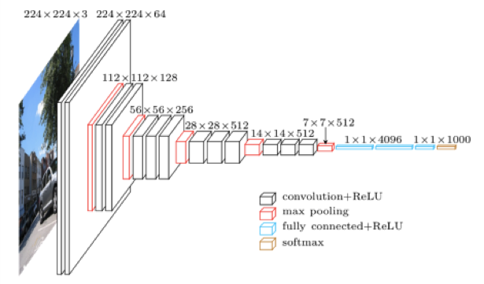
VGG¹
A convolutional deep neural network for image classification
Architecture
Advantages
11-19 layers, adjustable weights
Consistently performs very well on benchmarks
Several pre-trained versions exist
¹ Simonyan, Karen, and Andrew Zisserman. "Very Deep Convolutional Networks for Large-Scale Image Recognition." arXiv preprint arXiv:1409.1556 (2014).

Slide 35
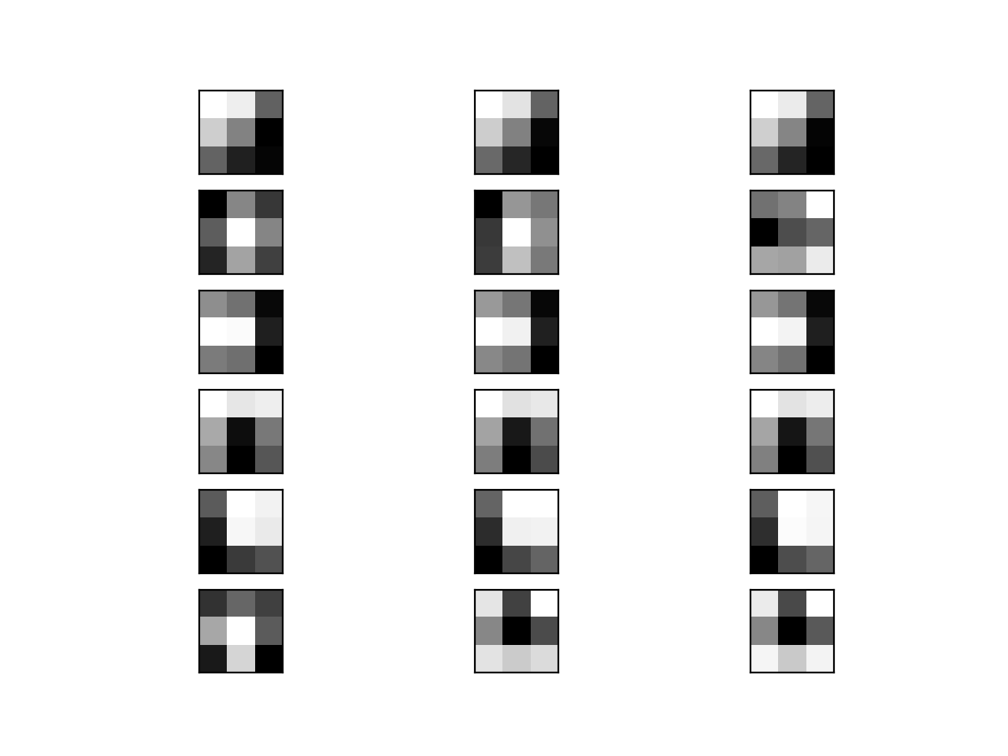
Visualizing Convolutional Layers of VGG16 trained on ImageNet¹
Kernel visualization - first 6 filters
¹ Browinee, Jason. "How to Visualize Filters and Feature Maps in Convolutional Neural Networks." https://machinelearningmastery.com/how-to-visualize-filters-and-feature-maps-in-convolutional-neural-networks/

Slide 36
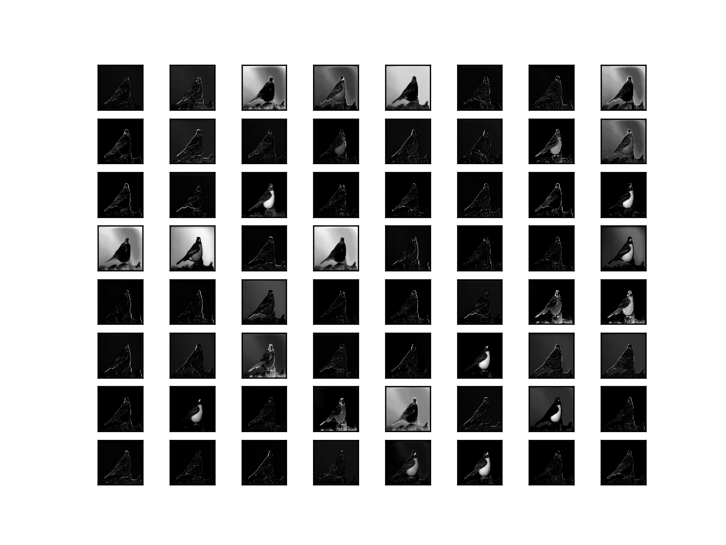
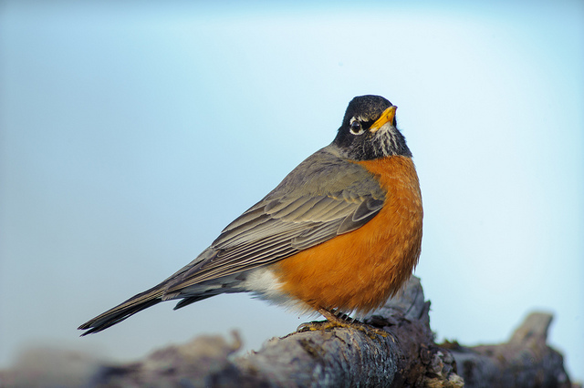
Visualizing Convolutional Layers of VGG16 trained on ImageNet¹
^{Feature maps - block 1}
¹ Browinee, Jason. "How to Visualize Filters and Feature Maps in Convolutional Neural Networks." https://machinelearningmastery.com/how-to-visualize-filters-and-feature-maps-in-convolutional-neural-networks/

Slide 37
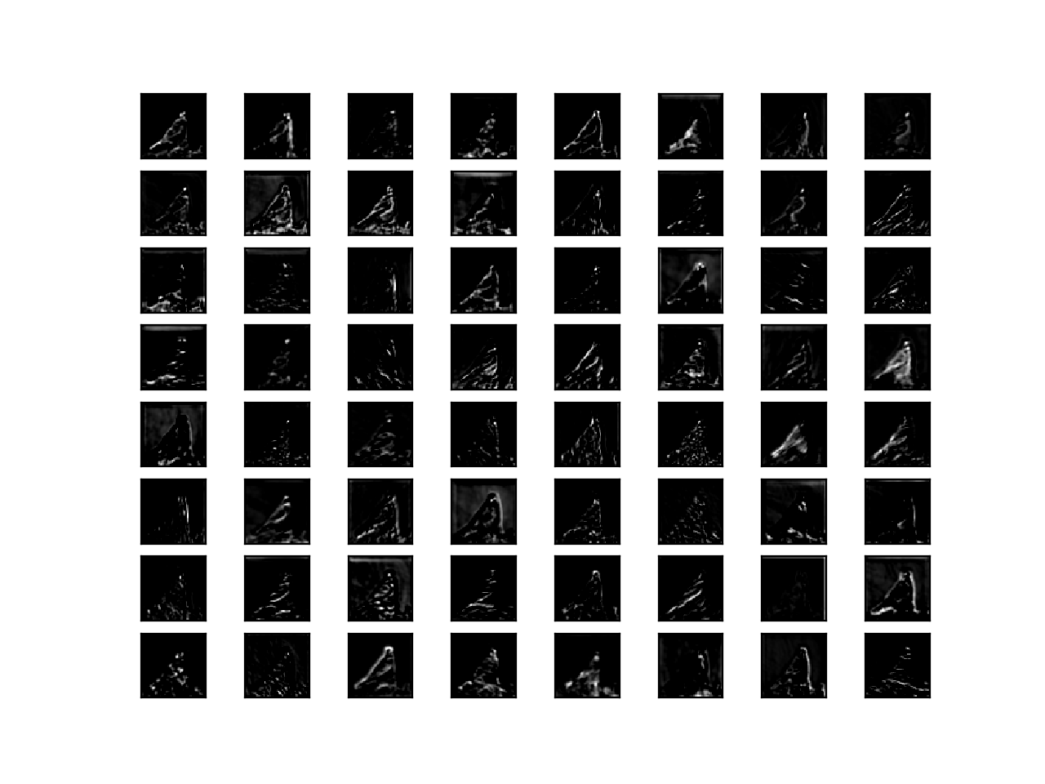
Visualizing Convolutional Layers of VGG16 trained on ImageNet¹
^{Feature maps - block 3}
¹ Browinee, Jason. "How to Visualize Filters and Feature Maps in Convolutional Neural Networks." https://machinelearningmastery.com/how-to-visualize-filters-and-feature-maps-in-convolutional-neural-networks/

Slide 38
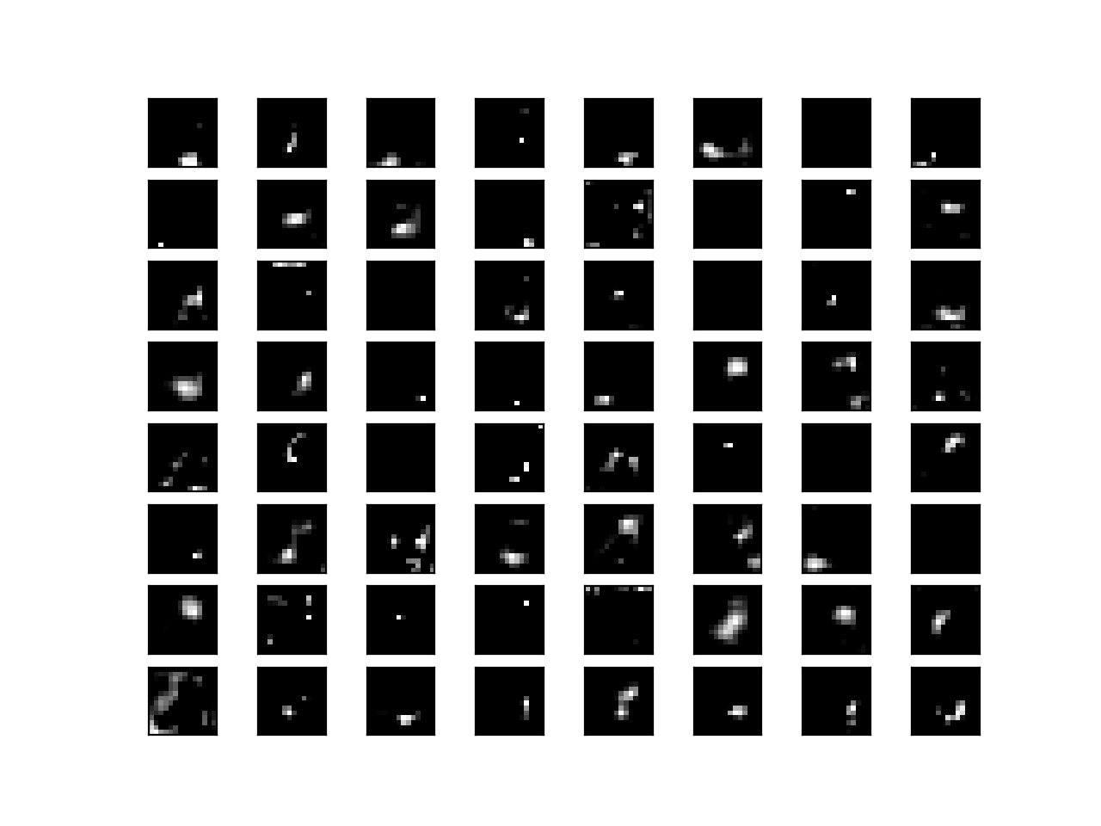
Visualizing Convolutional Layers of VGG16 trained on ImageNet¹
^{Feature maps - block 5}
¹ Browinee, Jason. "How to Visualize Filters and Feature Maps in Convolutional Neural Networks." https://machinelearningmastery.com/how-to-visualize-filters-and-feature-maps-in-convolutional-neural-networks/

Slide 39
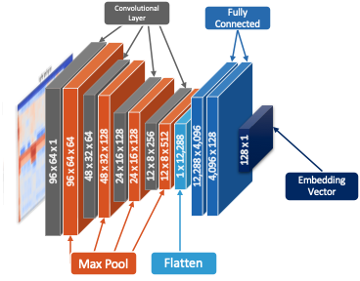
VGGish¹
A convolutional deep neural network for audio classification
Architecture
Advantages
VGG adapted for audio processing
11 layers, adjustable weights
Operates on log-mel spectrograms
Pre-trained model trained on Google’s AudioSet² data
¹ Hershey, Shawn, et al. "CNN architectures for large-scale audio classification." 2017 IEEE International Conference on Acoustics, Speech and Signal Processing (ICASSP). IEEE, 2017.
²Gemmeke, Jort F., et al. "Audio set: An ontology and human-labeled dataset for audio events." 2017 IEEE International Conference on Acoustics, Speech and Signal Processing (ICASSP). IEEE, 2017.

Slide 40
Use case: Recognizing Commands
04
Overview, datasets, and tools

Slide 41
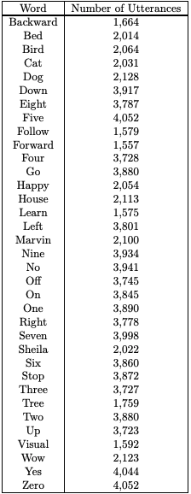
Use case: Recognizing Commands
Dataset - Speech Commands¹ v0.02
105,829 utterances of 35 different words
2,618 different speakers
1 second WAV files- 16-bit PCM at a 16 KHz sample rate
¹ Warden, Pete. "Speech commands: A dataset for limited-vocabulary speech recognition." arXiv preprint arXiv:1804.03209 (2018).

Slide 42
Workflow
01
04a
02
04b
03
04c
Preprocess
Feature extraction
Convert audio to input frames
Use output as vector embedding
Load
Use for transfer learning
Define VGGish structure, load checkpoint
Add trainable layers onto frozen network
Evaluate
Use as warm start
Feed spectrograms into VGGish
Use pre-trained weights as starting point

Slide 43
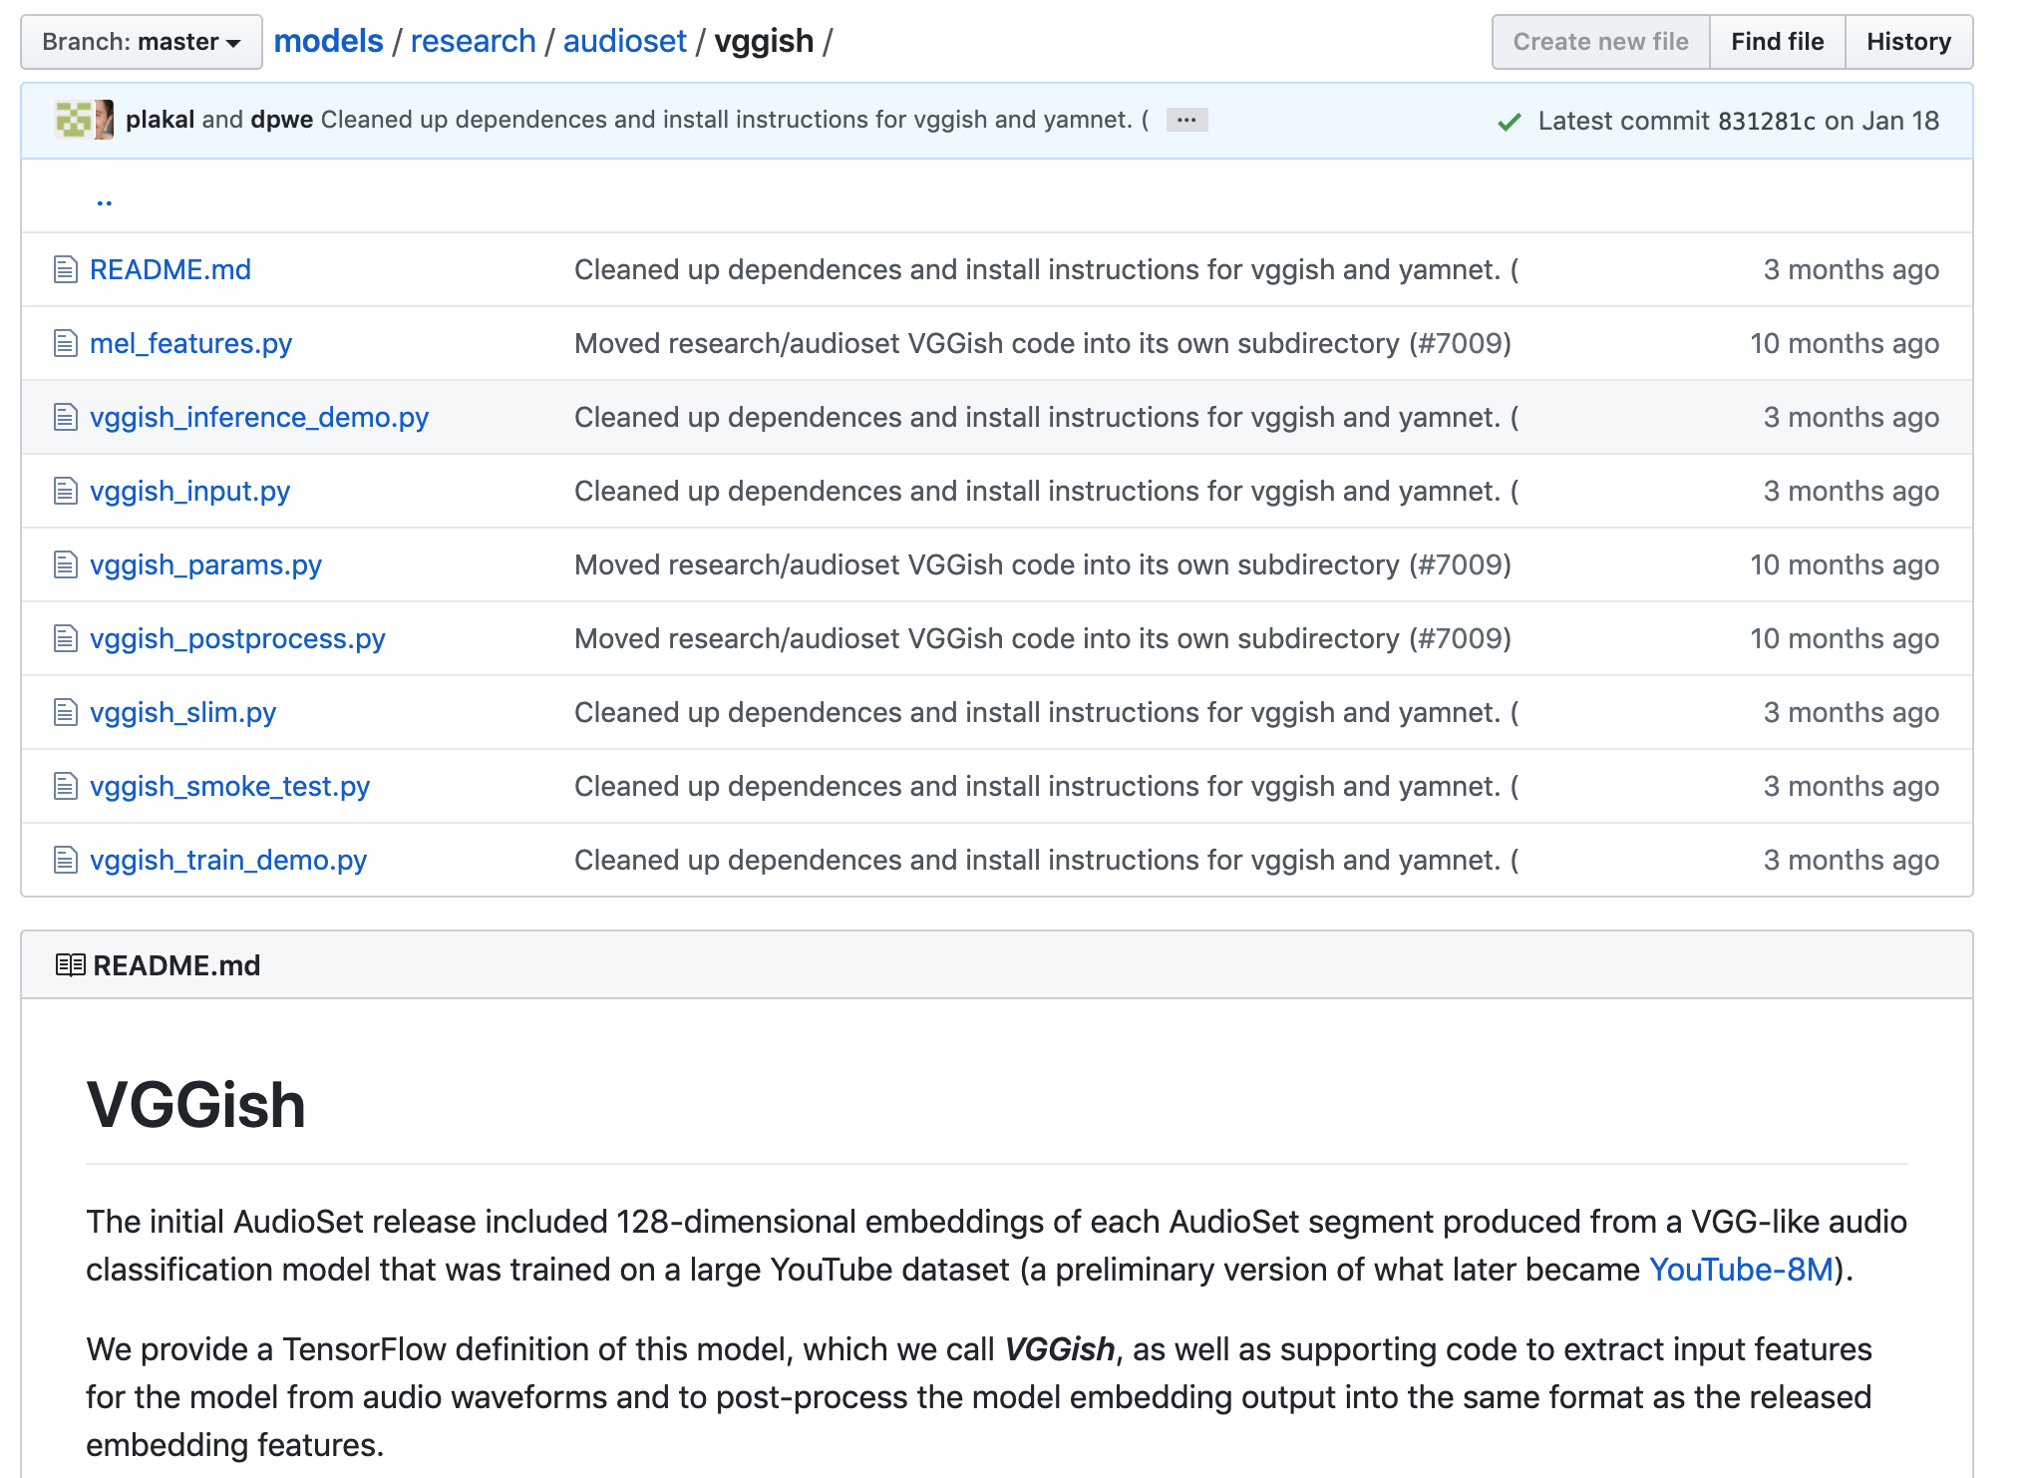
VGGish library
Publicly available source code and utilities
https://github.com/tensorflow/models/tree/master/research/audioset/vggish

Slide 44



Getting set up
Install dependencies
Download VGGish library and checkpoint files
https://github.com/tensorflow/models/tree/master/research/audioset/vggish
Develop using preferred tools

Slide 45
Loading audio for use with VGGish
Audio resampled to 16 kHz mono.
Compute spectrogram.
Map the spectrogram to 64 mel bins covering the range 125-7500 Hz and take the log of the mel spectrogram.
Each audio sample mapped to non-overlapping 0.96 second segments, where segment is composed of 64 mel bands covering 96 10 ms frames
Processing performed by VGGish library

Slide 46
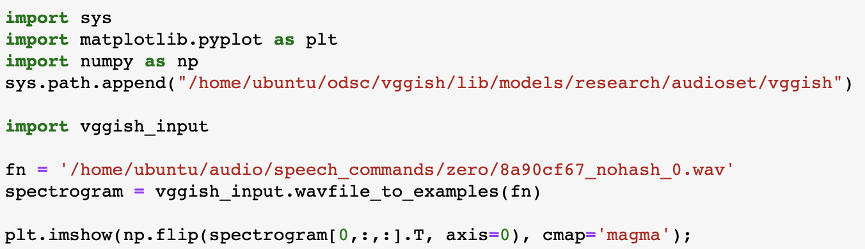
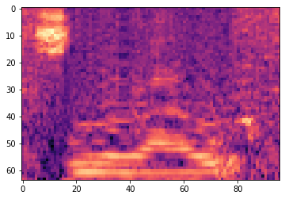
Loading audio and generating spectrograms

Slide 47
Feature extraction with VGGish
Steps:
Define network
Load checkpoint (pre-trained weights)
Use network to process spectrogram
Using VGGish to generate vector embeddings of audio

Slide 48
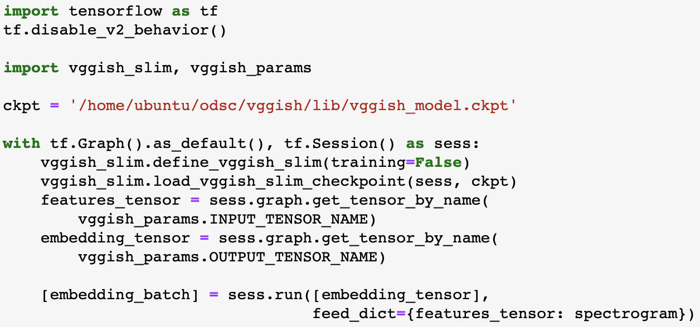
Defining network, loading weights, generating embeddings

Slide 49
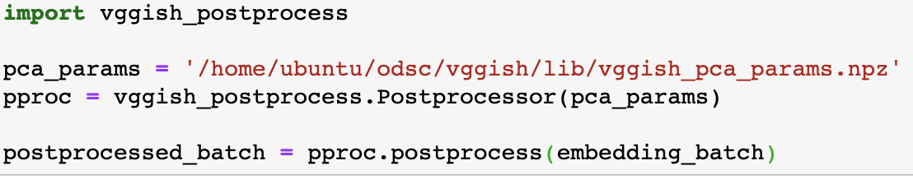
VGGish post-processing

Slide 50
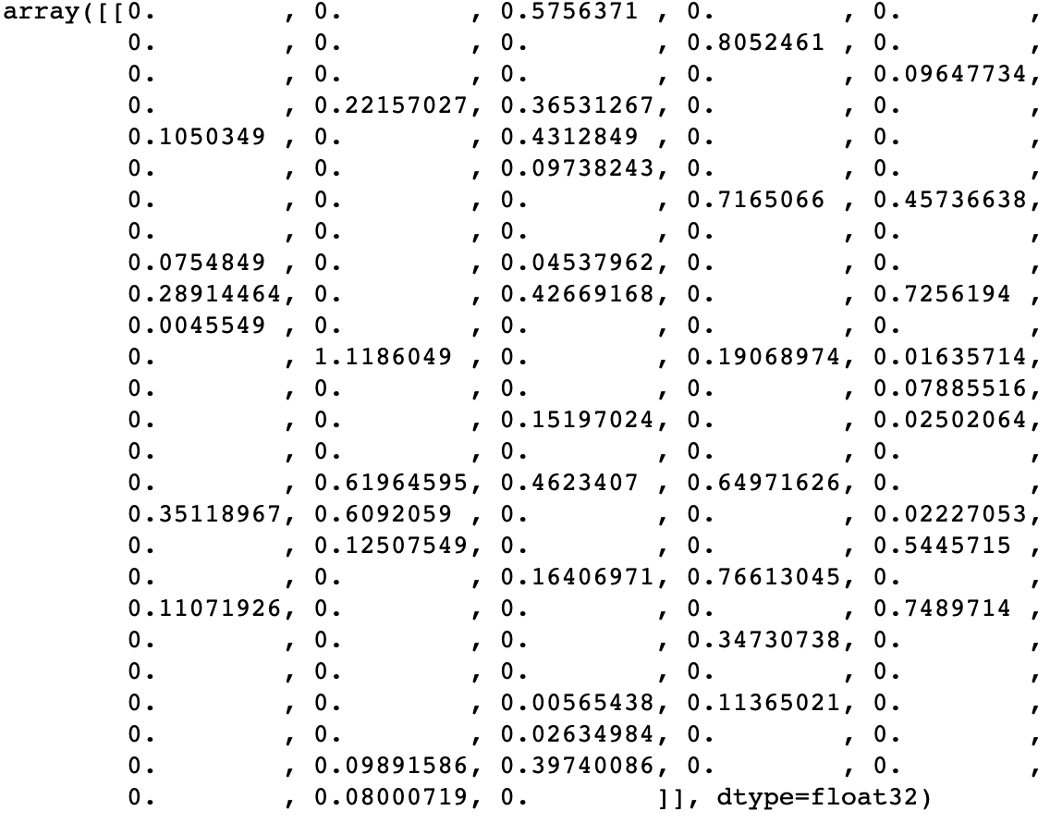
VGGish output:
raw vs post-processed
Raw network output

Slide 51
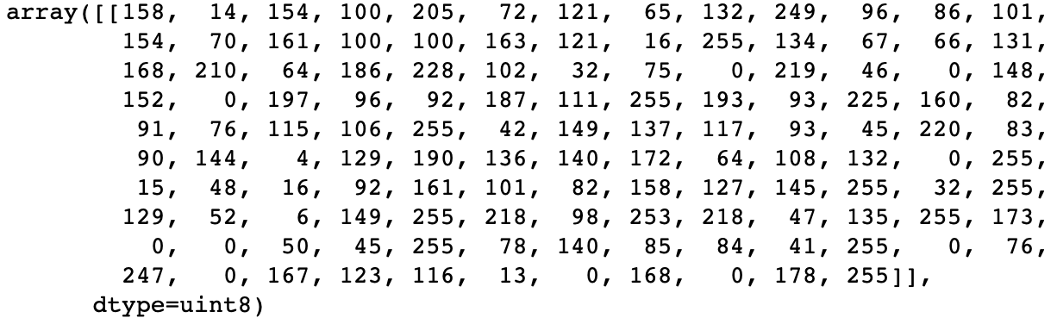
VGGish output:
raw vs post-processed
Post-processed output

Slide 52
Why post-process?
Native output of VGGish: 128-dimensional encoding of each example frame evaluated by the network
VGGish also includes a post-processing capability in order to maintain compatibility with YouTube-8M (which has released visual/audio embeddings for millions of videos). Post-processor performs PCA, whitening, and quantizes output to 8 bits.
Why post-process?
Only if you need to work with other embeddings
Typically easier to work with raw version of embeddings

Slide 53
Next steps
Using vector embeddings
Embeddings can be used in place of the raw audio in other algorithms (e.g. k-means) or models (e.g. xgboost)

Slide 54
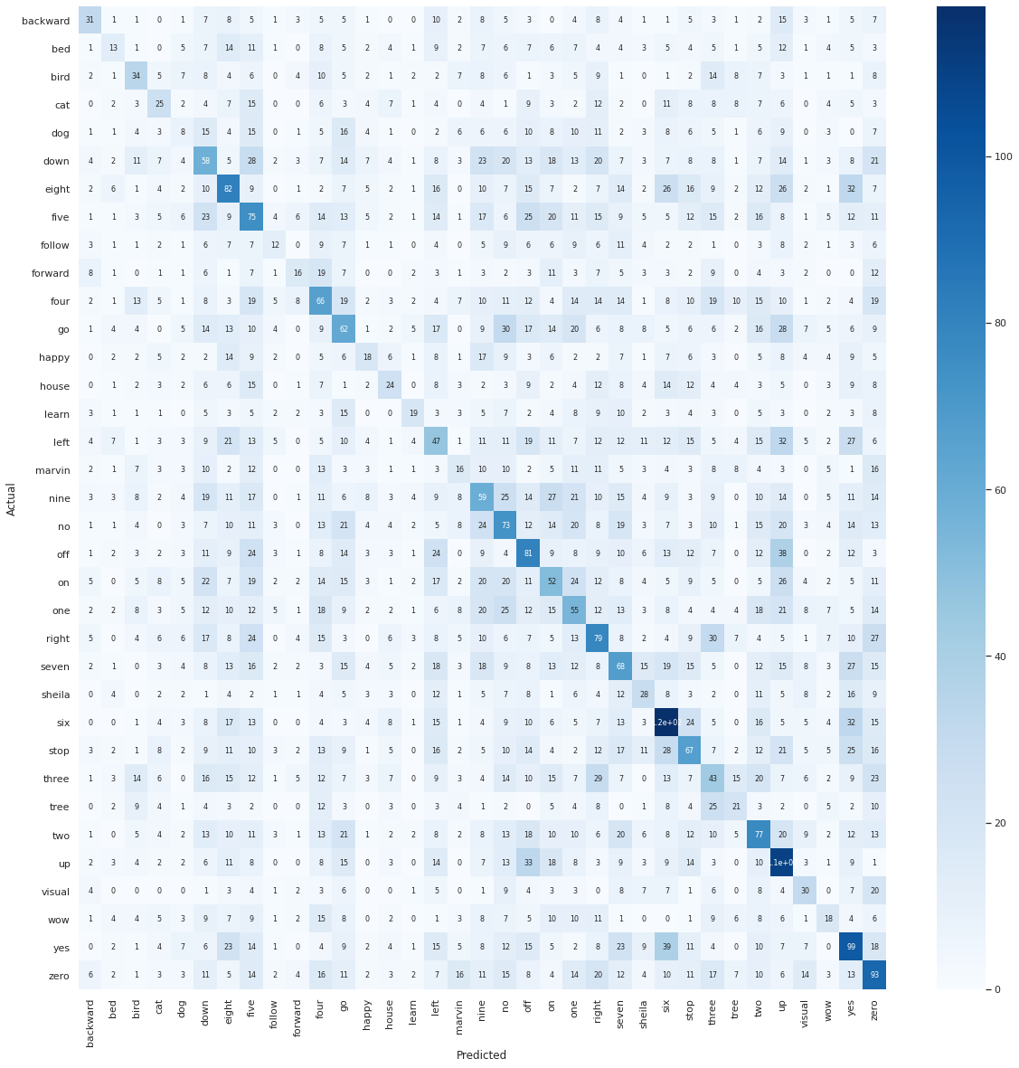
Experimental results
XGBoost using embeddings
Overall accuracy - 18.4%

Slide 55
Transfer learning with VGGish
Steps:
Define network - with frozen layers
Load checkpoint (pre-trained weights)
Add trainable layers onto network
Train network - only additional layers
Using the VGGish network as a base for additional layers

Slide 56
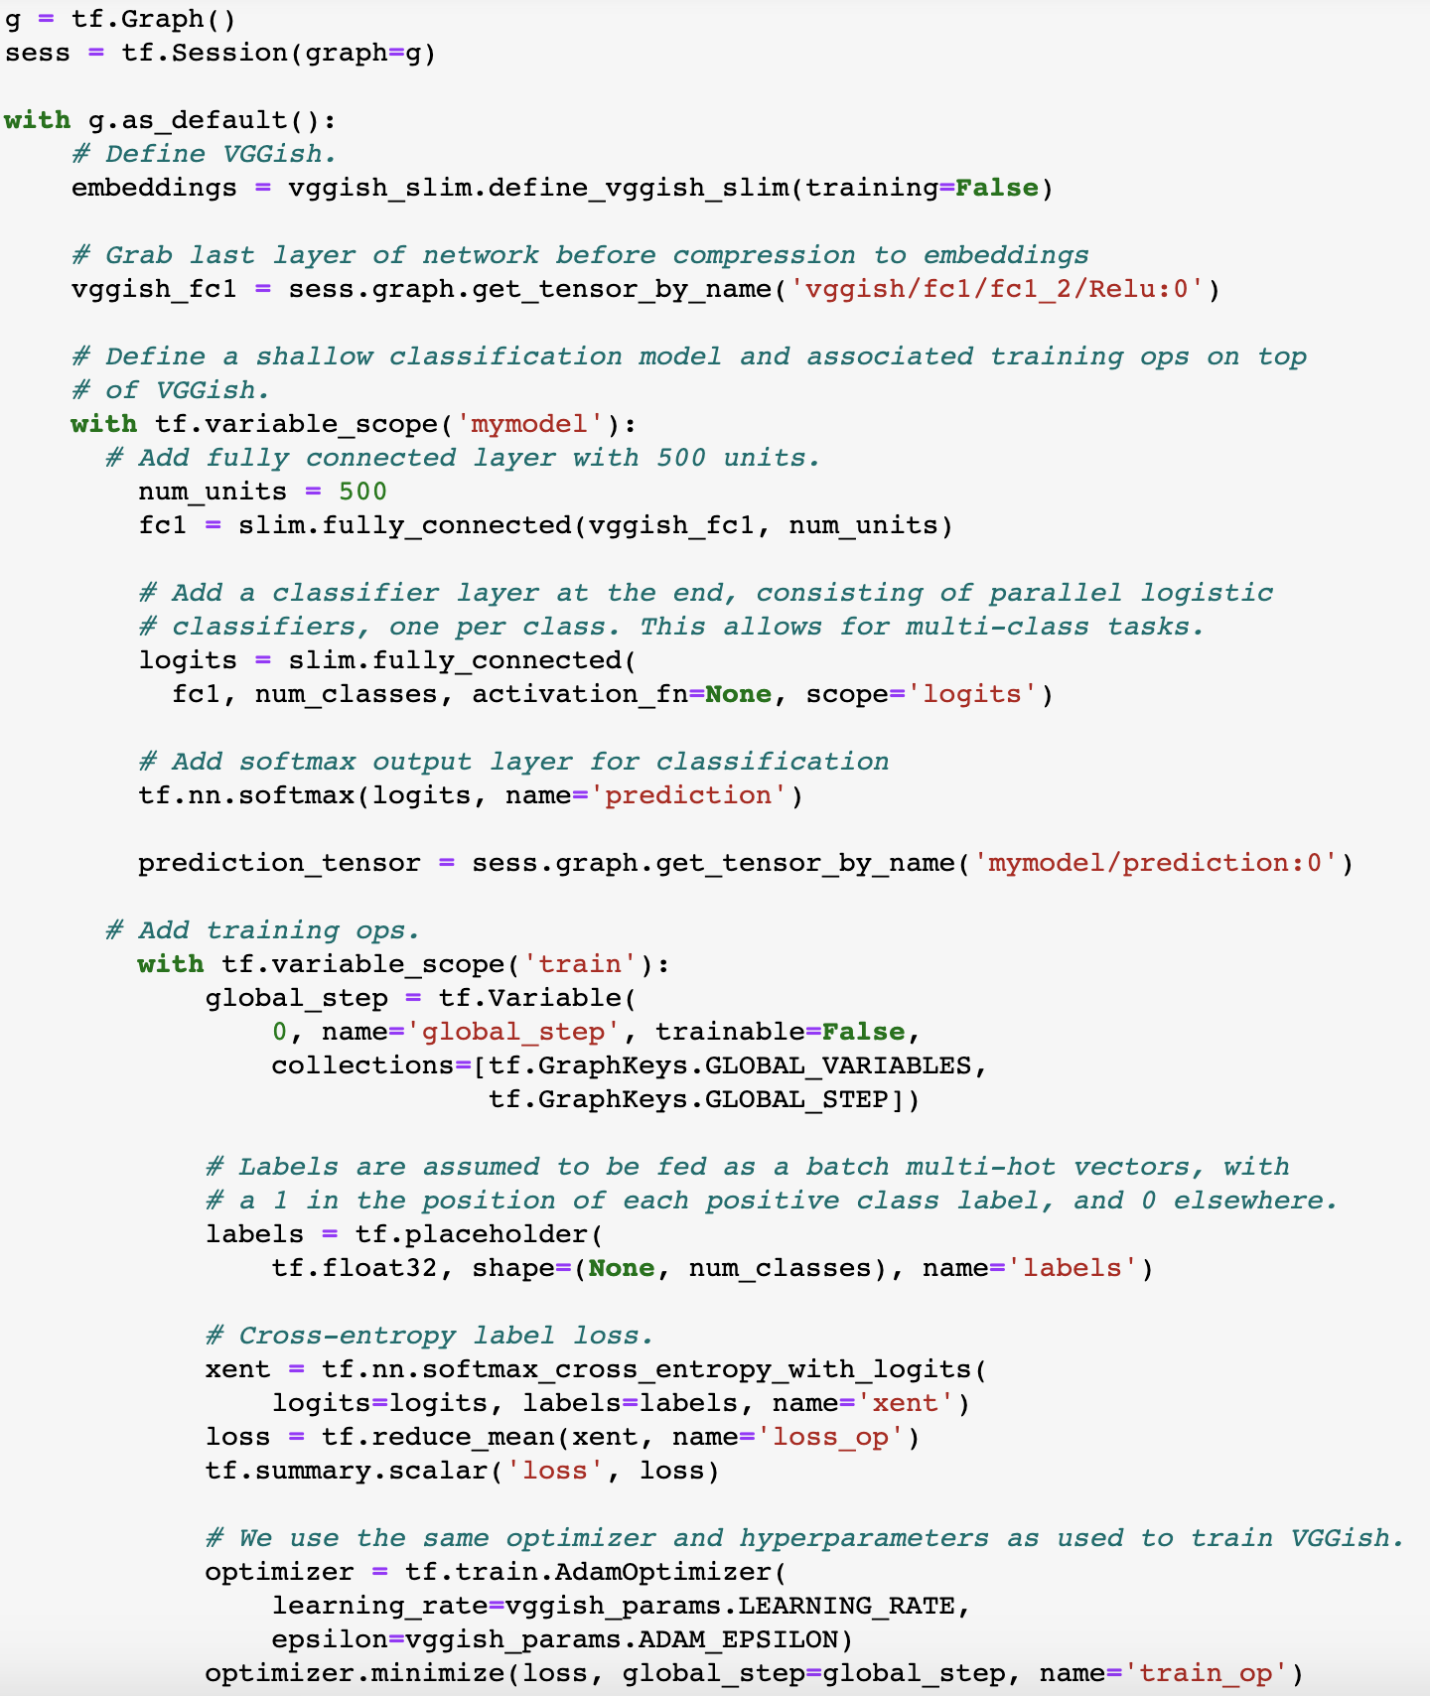
Defining and extending the network

Slide 57
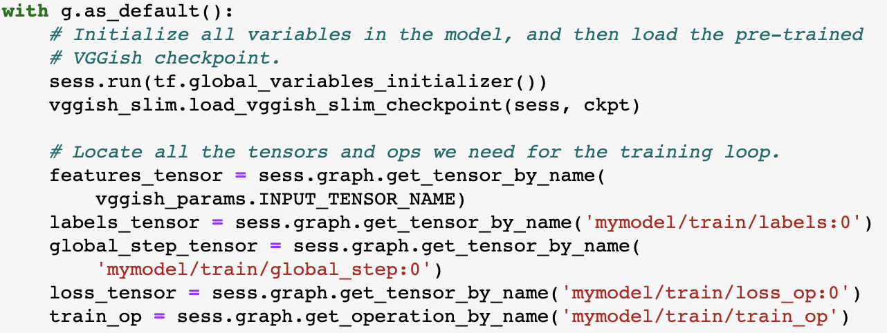
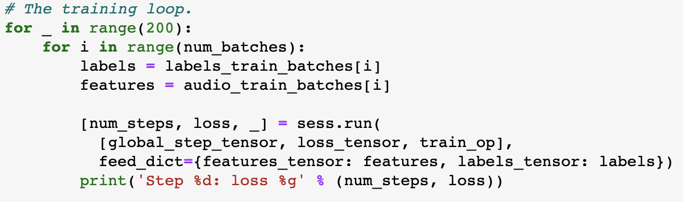
Initializing and training
Training:
100,000 batches of 500
Run on EC2 (p3.2xlarge)
One Tesla V100-SXM2-16GB GPU
Final loss
1.17431
Run time
28 min

Slide 58
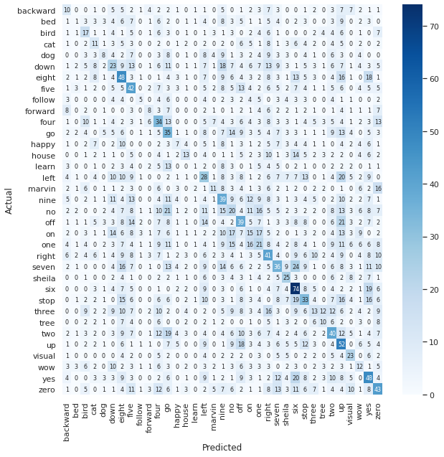
Experimental results
Extending VGGish
Overall accuracy - 30.4%

Slide 59
VGGish as a warm start
Steps:
Define network - with trainable layers
Load checkpoint (pre-trained weights)
Add trainable layers onto network
Train network - including base layers
Retraining and fine-tuning VGGish

Slide 60
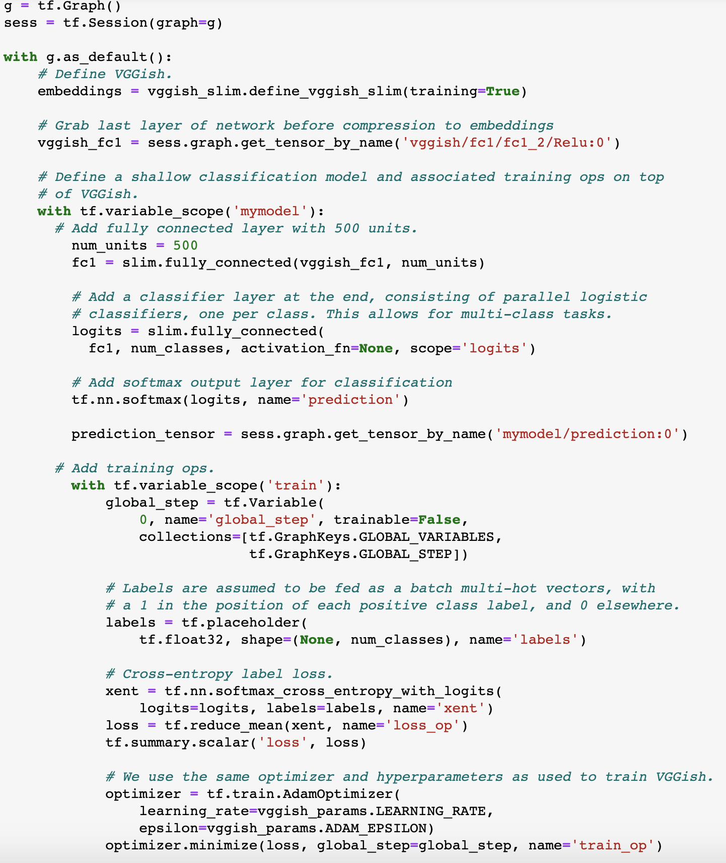
Defining and extending the network

Slide 61
Initializing and training
Training:
100,000 batches of 500
Run on EC2 (p3.2xlarge)
One Tesla V100-SXM2-16GB GPU
Final loss
1.45928e-07
Run time
1 hr 20 min

Slide 62
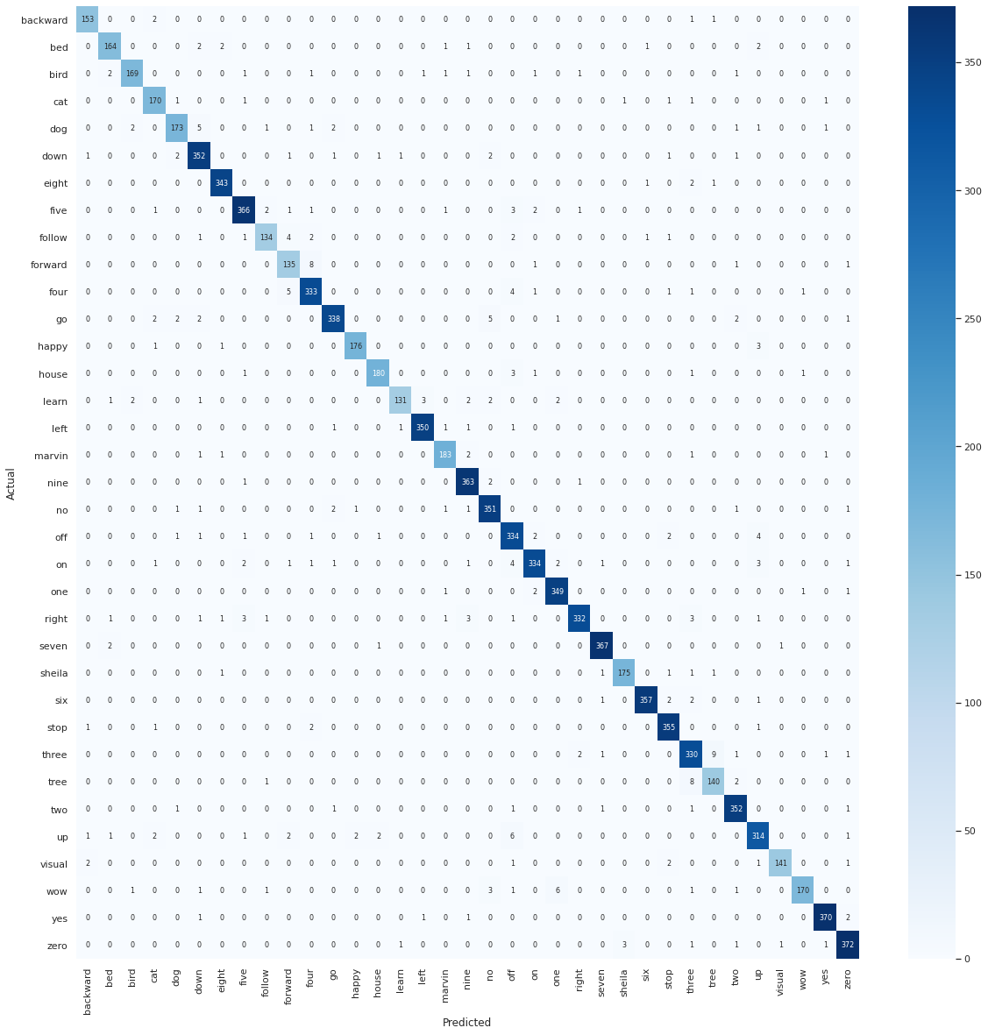
Experimental results
Retraining VGGish
Overall accuracy - 96.6%

Slide 63

In closing...
What have we learned?
Audio representations
Deep learning
VGGish
Results
Mel frequencies and spectrograms
Convolution, pooling, VGG, VGGish
Trained on AudioSet
Warm start performs the best but requires the most training

Slide 64
Code available on GitHub -
https://github.com/RobertCoop/ODSCEast2020

